Slide 1
Master’s Thesis Presentation
Dhruvil Anil Darji
Advisor :- Dr. Gustavo Vejarano
Electrical Engineering and Computer Science Department
Date :- 05/04/2018
Total Credits :- 6

Slide 2
TITLE
Counting And Locating Targets Using Multiple Drones On The Fly

Slide 3
Outline
Thesis part 1 – Single UAV
System Set Up
Algorithm
Experimental Evaluation
Thesis part 2 – Multiple UAV
System Set Up
Algorithm
Experimental Evaluation

Slide 4
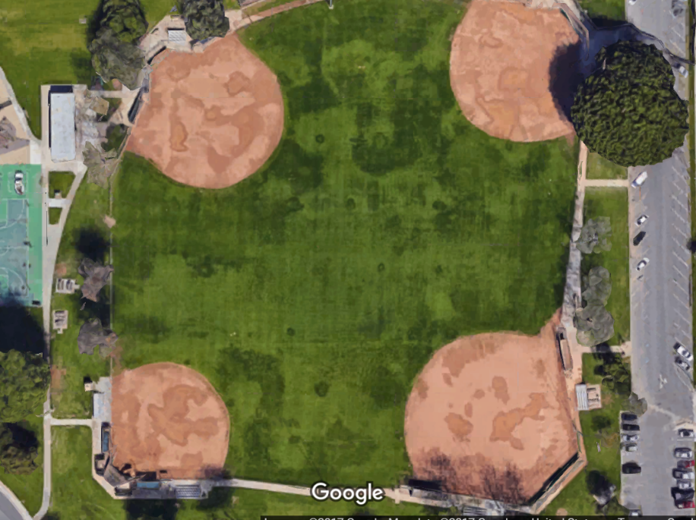
System Setup
Experiments took place in Artesia park.
Since LMU is situated in Class B airspace of LAX Airport, we can not fly the drones in this airspace by rules of Federal Aviation Administration(FAA).
FAA certified Remote Pilot license is required to do research on the drones.

Slide 5

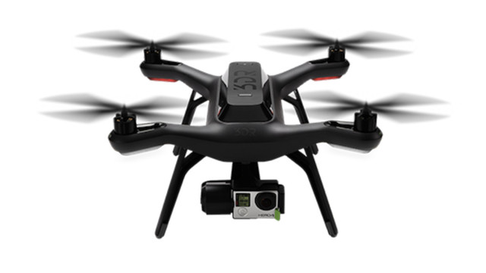
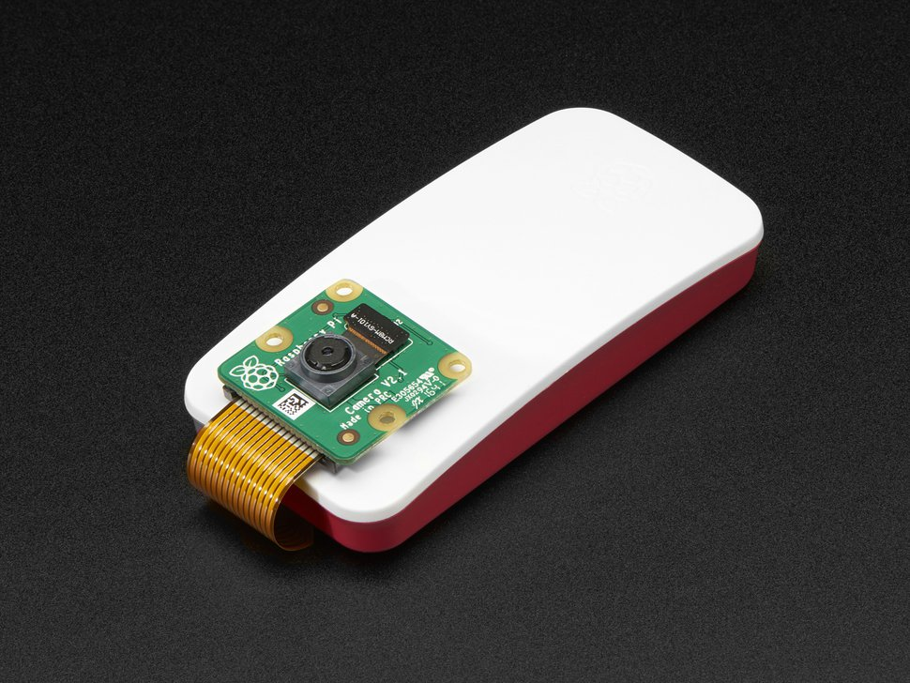

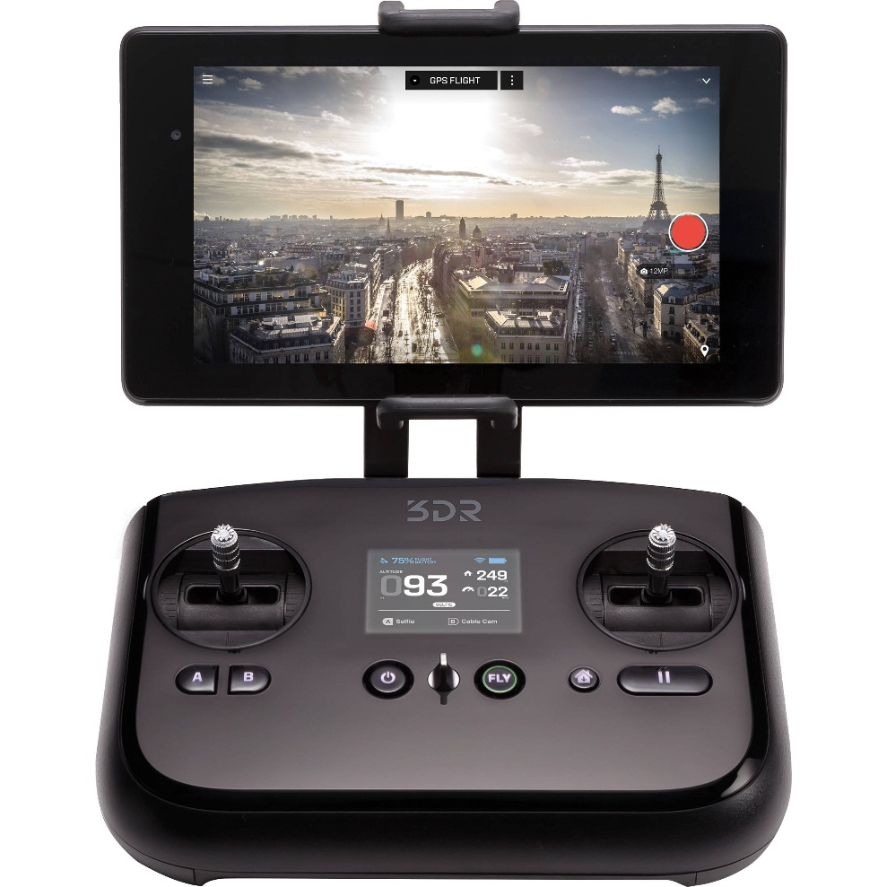
System Setup
Raspberryp Pi Zero W
Laptop Computer
Solo Drone
Mobile
Solo Controller

Slide 6
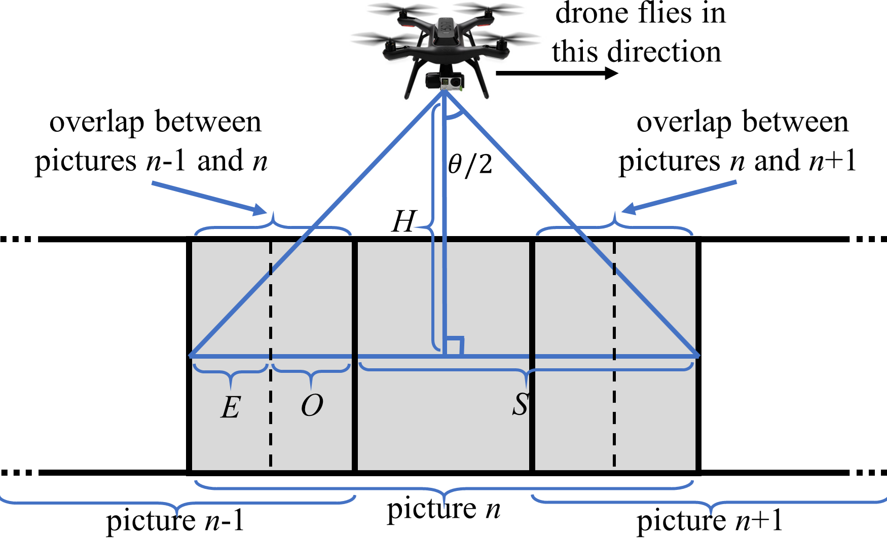
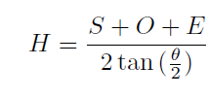
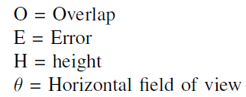
System Setup
Height of The Drone
S = Step Size

Slide 7
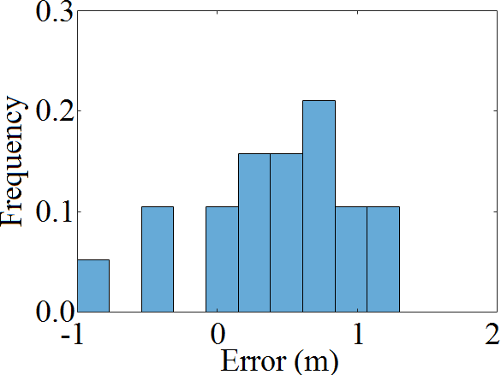
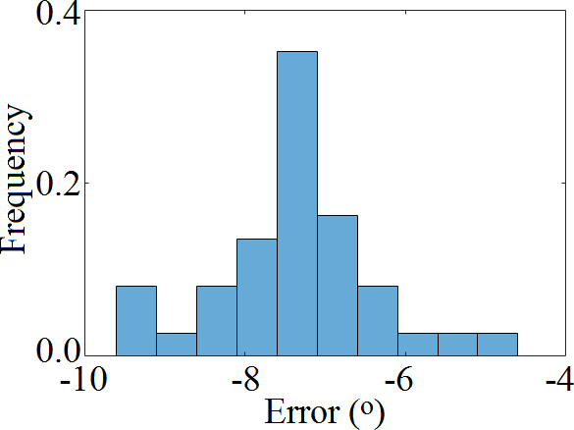
System Setup
Step Size Error
Direction Error

Slide 8
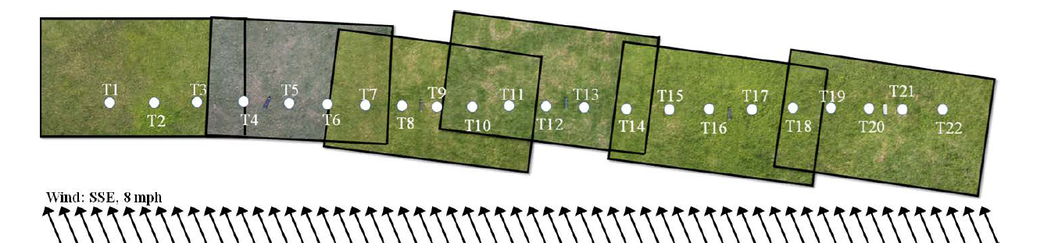
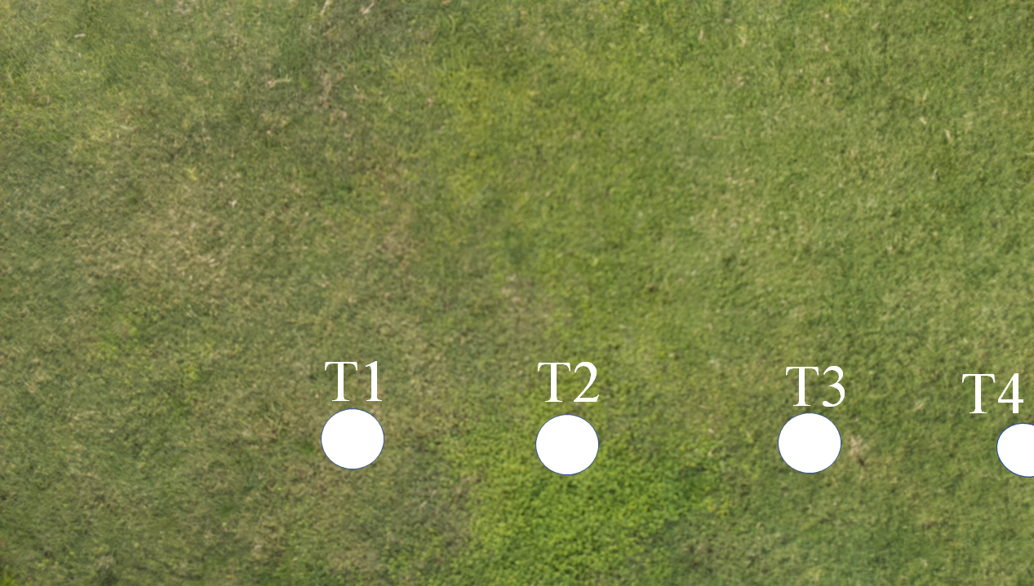
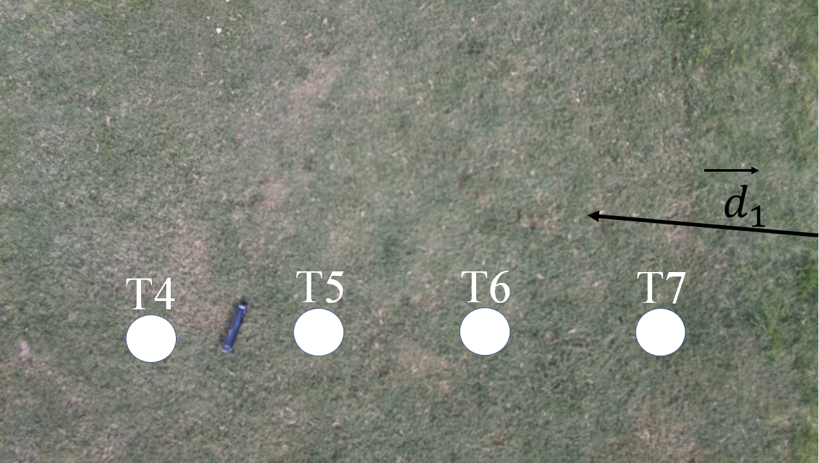
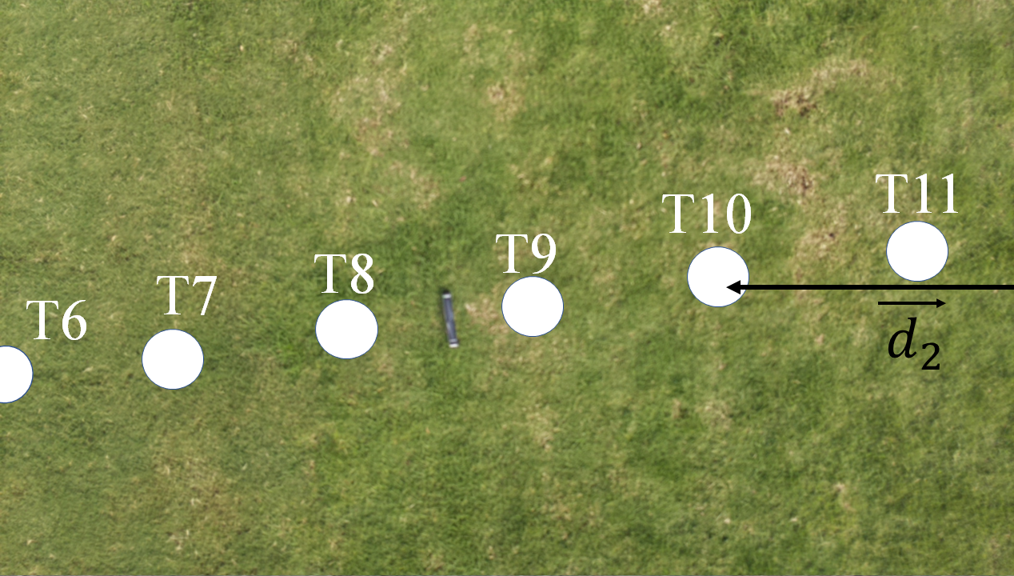
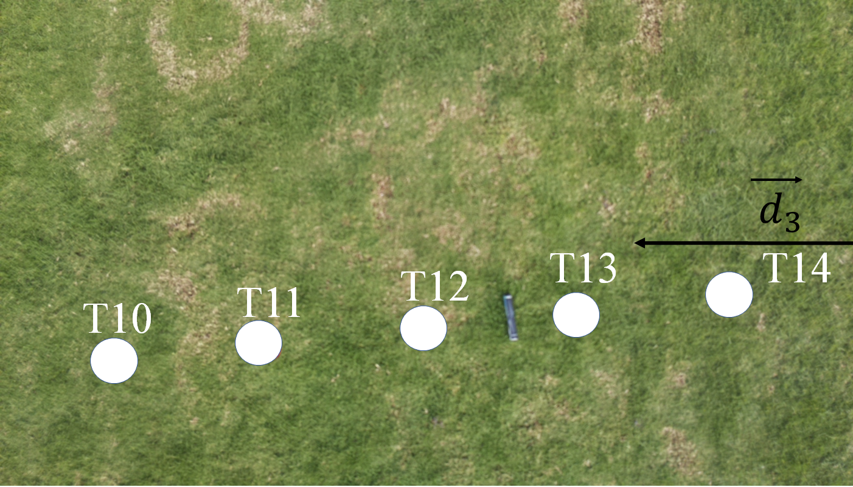
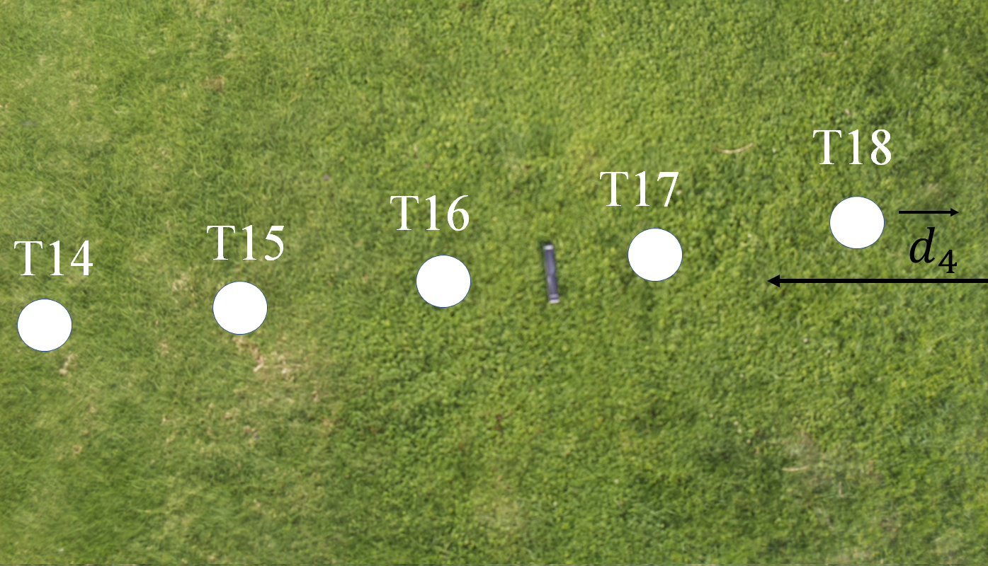
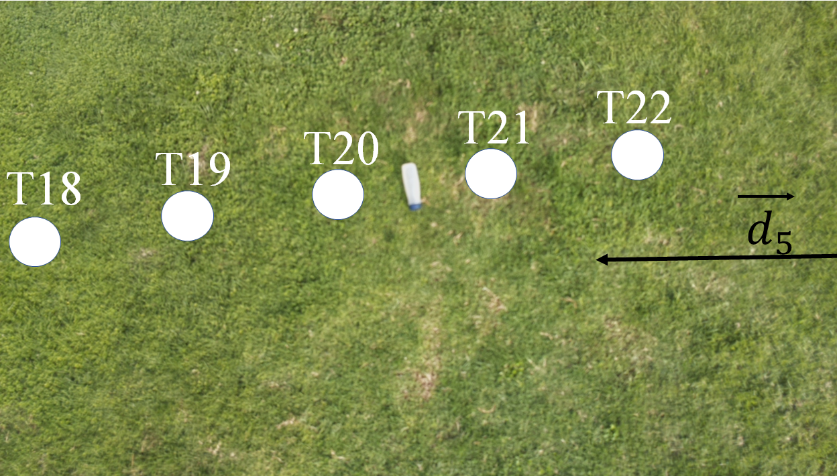
System Setup
Images Taken By the Drone
Image 1
Image 2
Image 3
Image 4
Image 5
Image 6

Slide 9
Outline
Thesis part 1 – Single UAV
System Set Up
Algorithm
Experimental Evaluation
Thesis part 2 – Multiple UAV
System Set Up
Algorithm
Experimental Evaluation
3

Slide 10
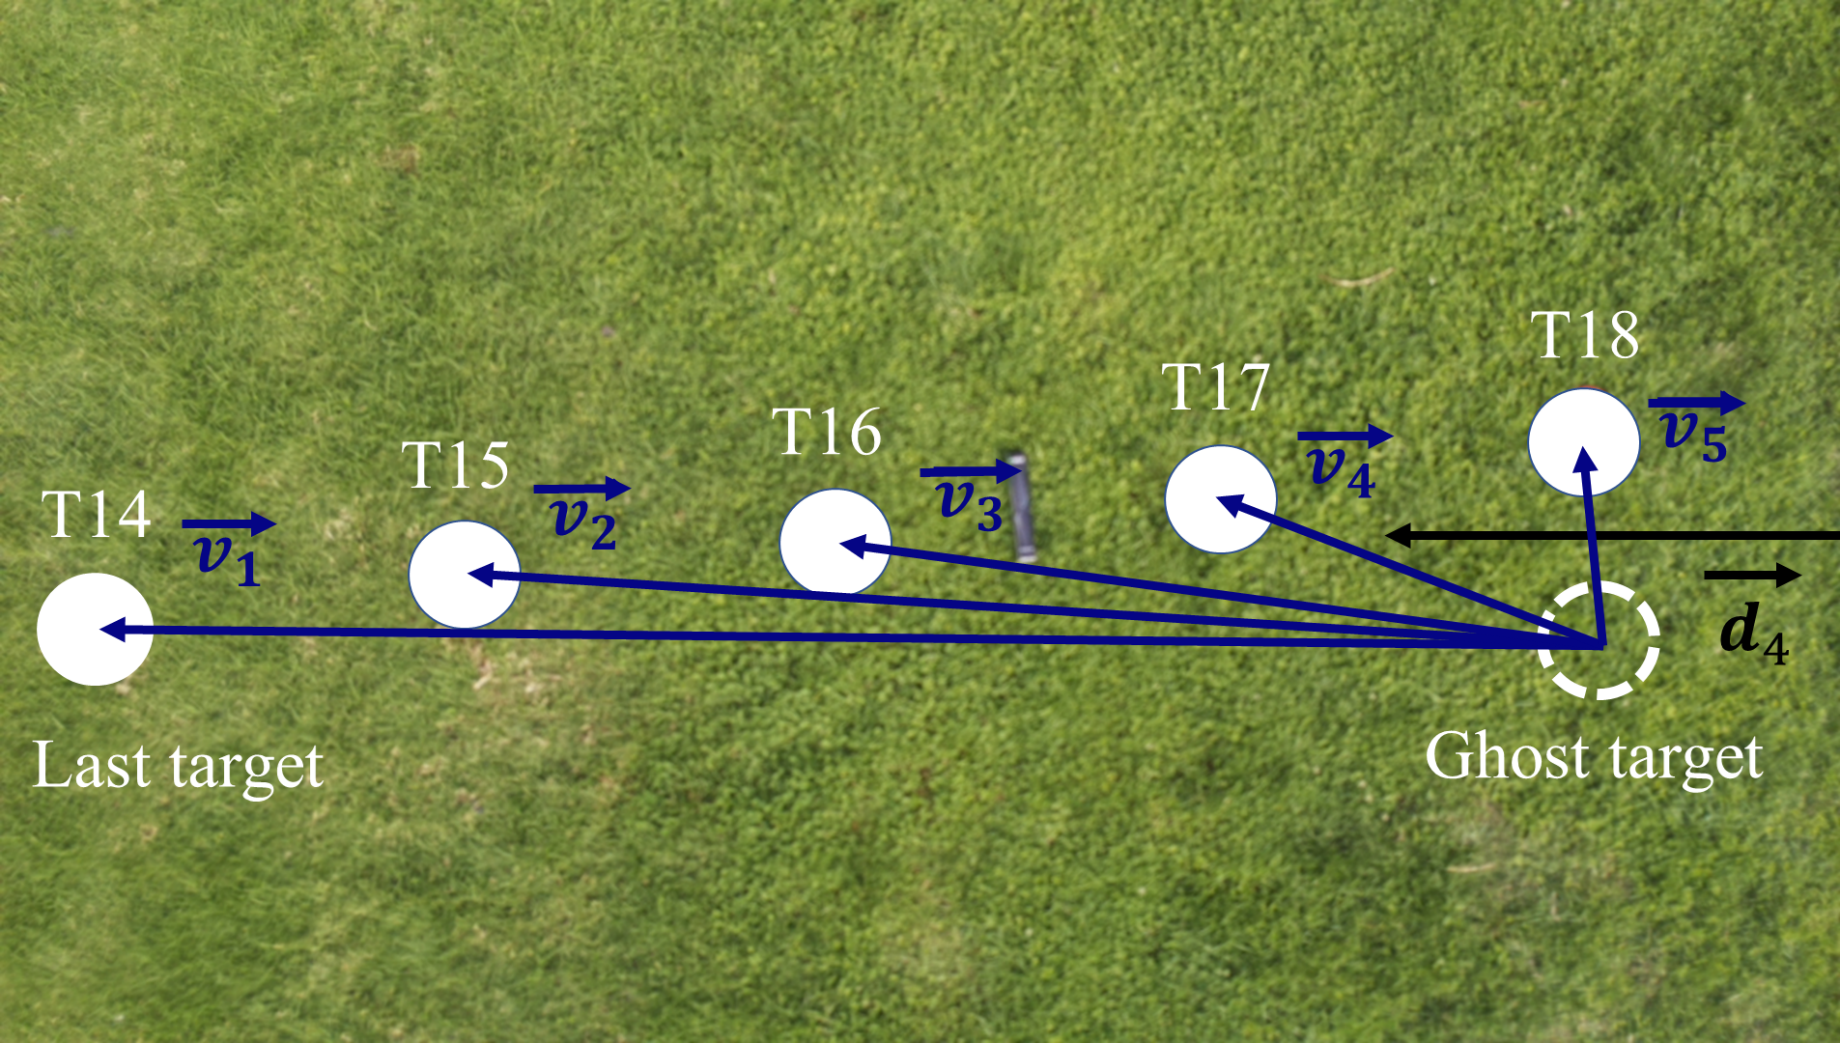
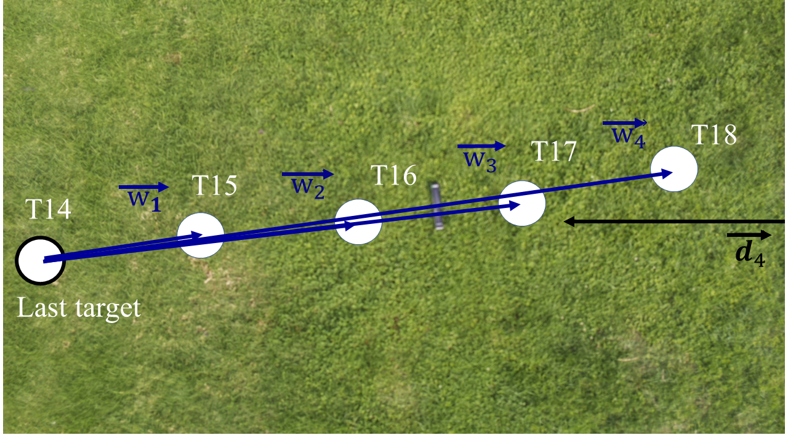
Algorithm
Vector Algorithm
Picture 1
Picture 2
Picture 2

Slide 11
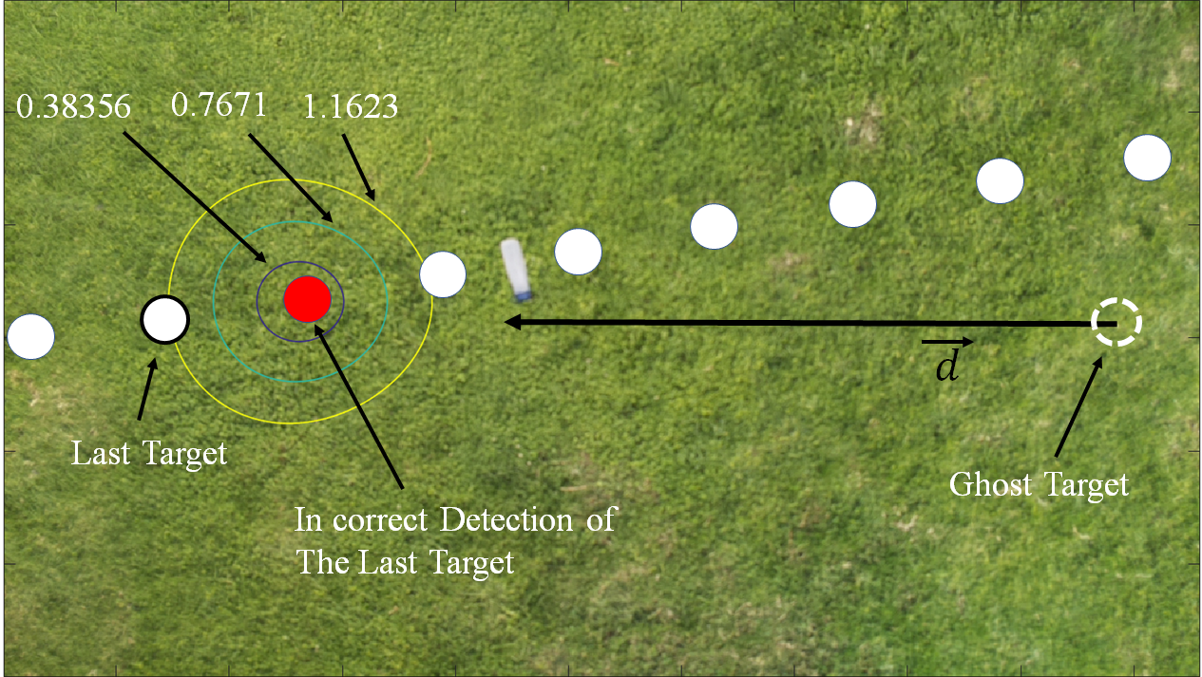
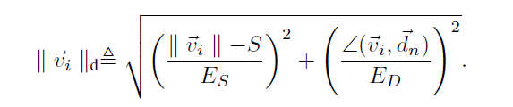
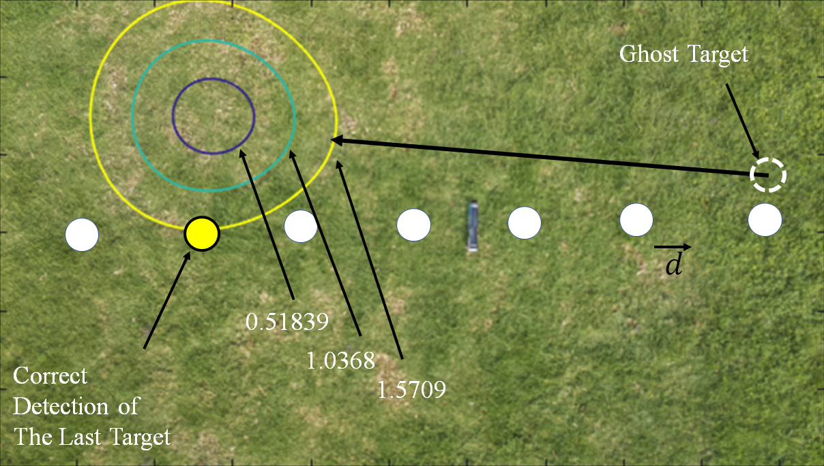
Algorithm
Deviation Region
Incorrect Detection
Correct Detection

Slide 12
Outline
Thesis part 1 – Single UAV
System Set Up
Algorithm
Experimental Evaluation
Thesis part 2 – Multiple UAV
System Set Up
Algorithm
Experimental Evaluation
3

Slide 13
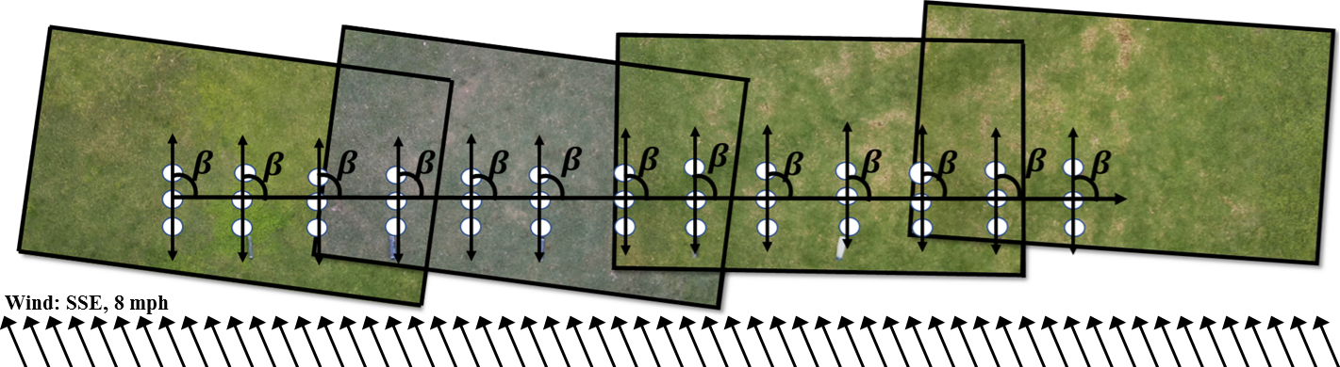
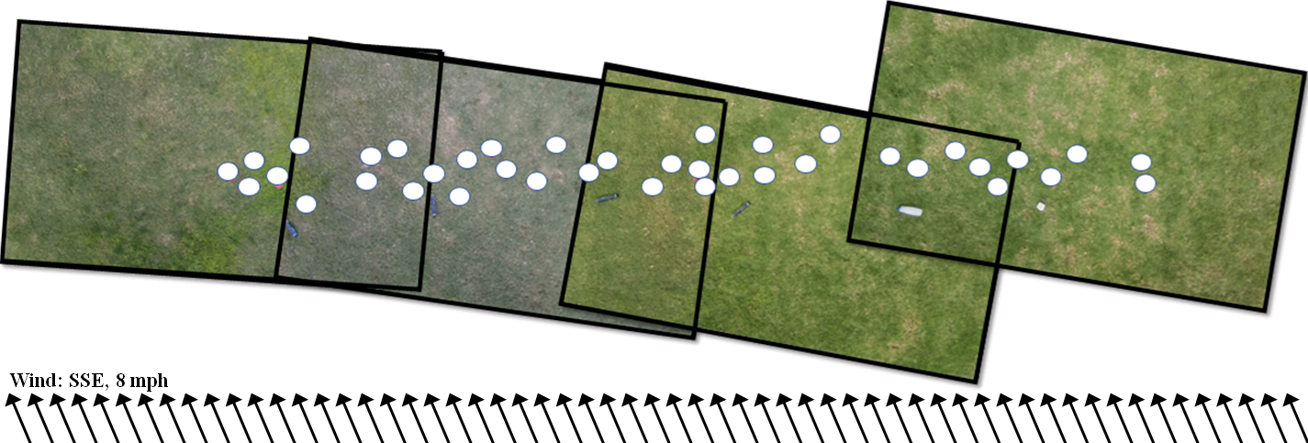
Experimental Evaluation

Slide 14
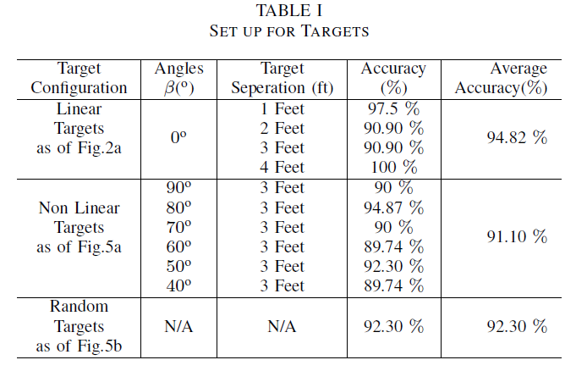
Experimental Evaluation
Accuracy of The Counting Targets

Slide 15
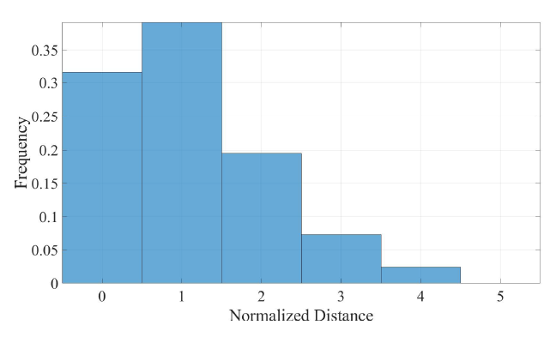
Normalized Distance between the actual last target and the target detected by the algorithm
Conference: Computer and Robot Vision (CRV 2018) Ontario, Canada. May’ 2018

Slide 16
Outline
Thesis part 1 – Single UAV
System Set Up
Algorithm
Experimental Evaluation
Thesis part 2 – Multiple UAV
System Set Up
Algorithm
Experimental Evaluation
3

Slide 17
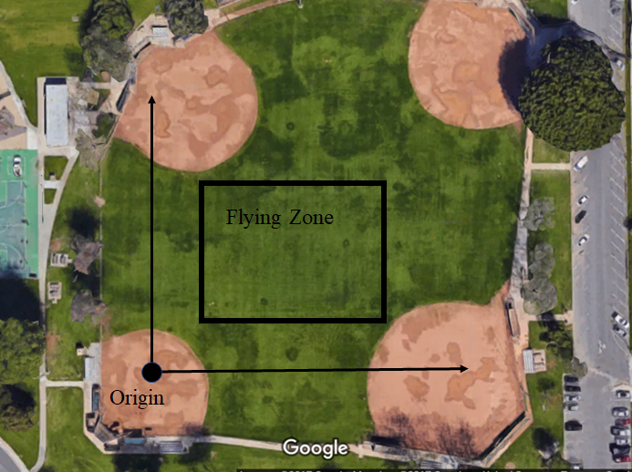
System Setup
Multiple UAVs count the Static targets on-the-fly
The same set up for Raspberry Pi, Camera, Height, and Flight Paths has been used
UAVs coordinate with each other to share the location of each other
All the target locations are delivered to the ground computer which can be UAV itself

Slide 18
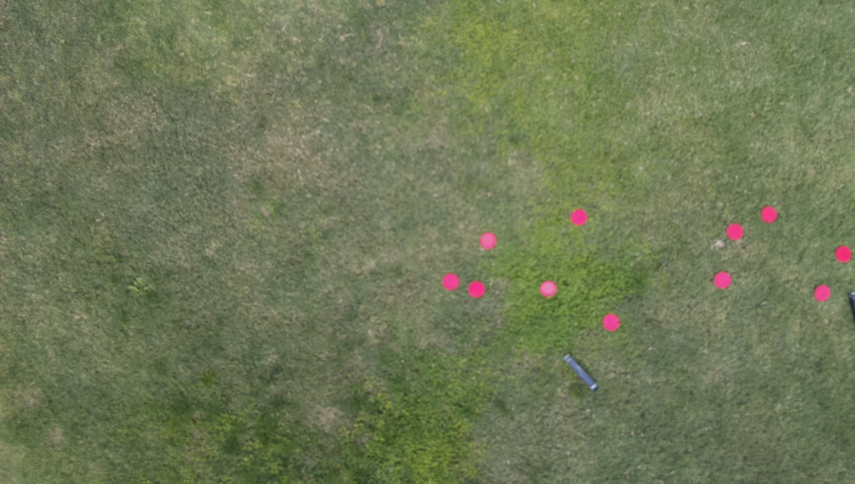
System Setup
L
Center Coordinate
(GPS Coordinate)
W
Perimeter Center Coordinates
Image Corner Coordinates
12

Slide 19
Outline
Thesis part 1 – Single UAV
System Set Up
Algorithm
Experimental Evaluation
Thesis part 2 – Multiple UAV
System Set Up
Algorithm
Experimental Evaluation
3

Slide 20
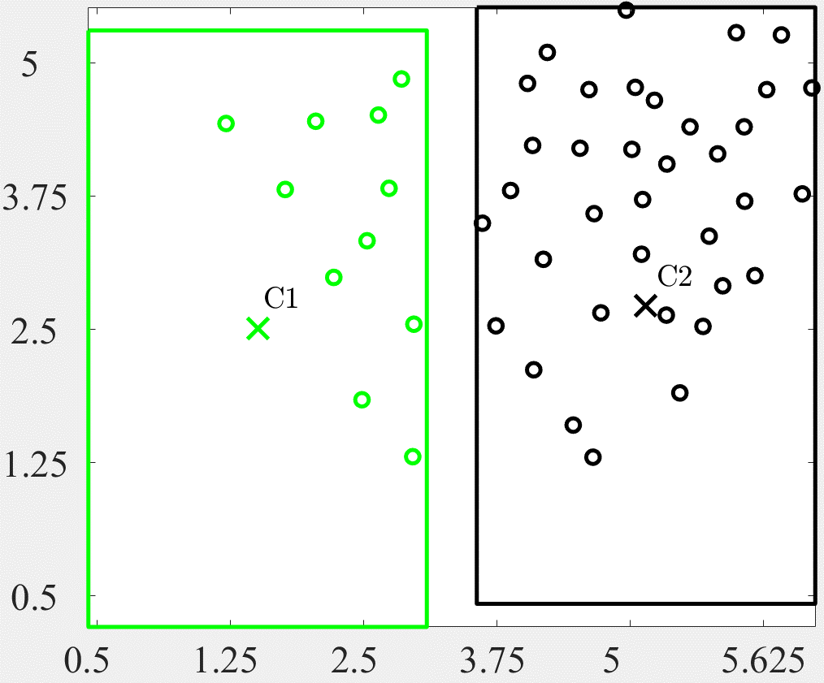
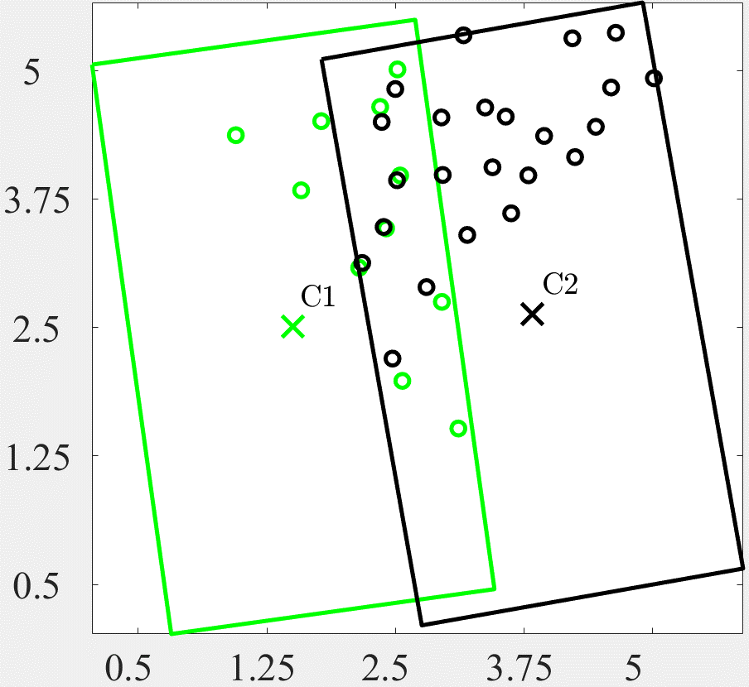
Algorithm
The Target counting algorithm is called as point set registration algorithm (PSR algorithm)

Slide 21
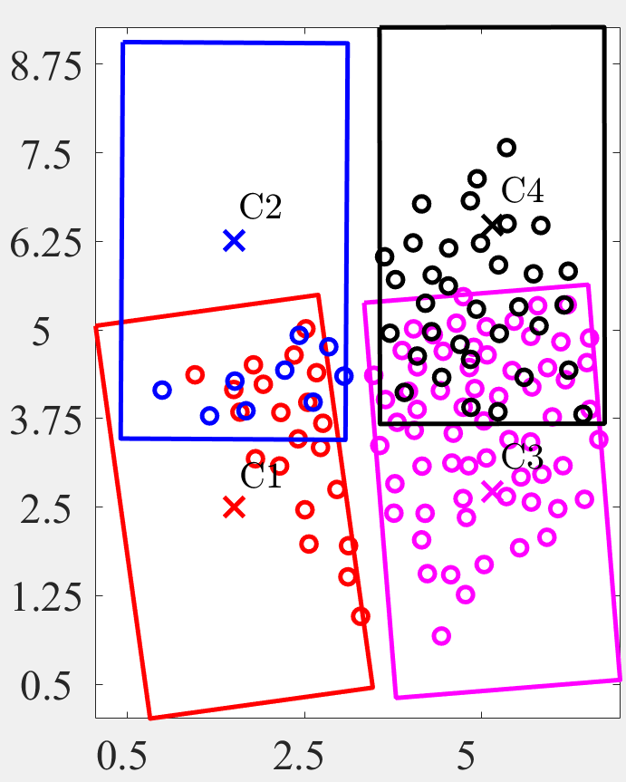
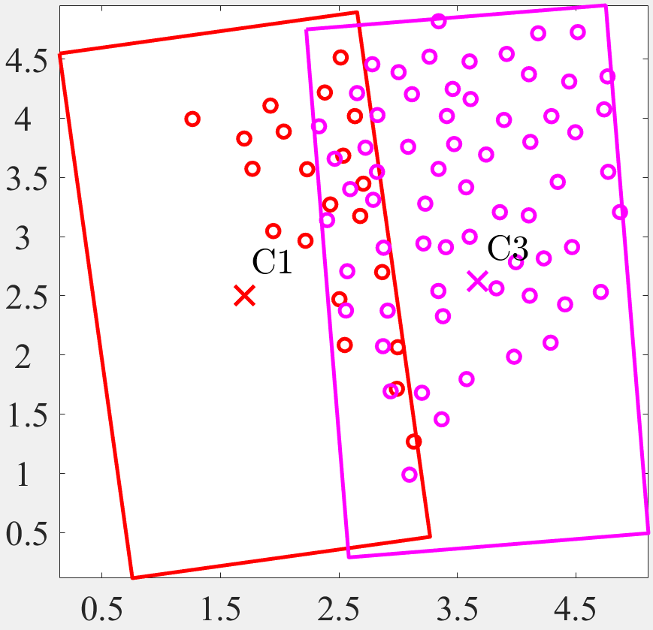
Algorithm
Reoriented Images with Yaw Error
Maximize the overlap

Slide 22
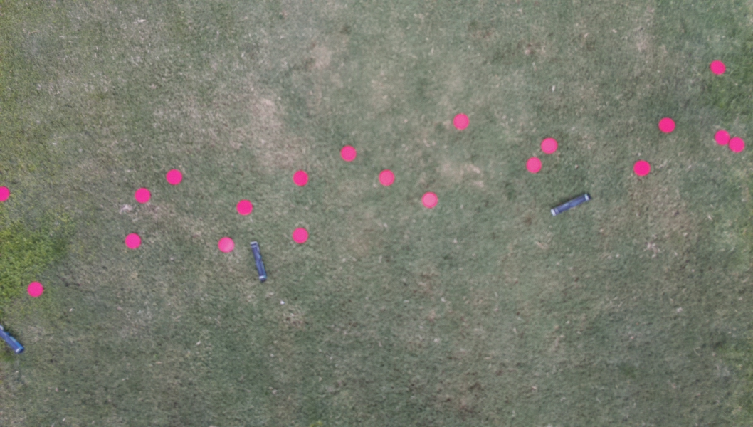
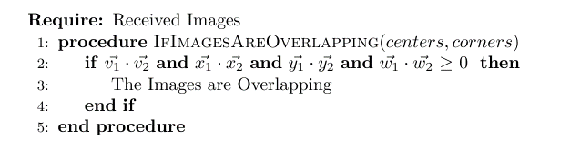
Algorithm
If the coordinate is inside or outside of the picture
v2
v1
w2
y2
w1
y1
x1
x2
14

Slide 23
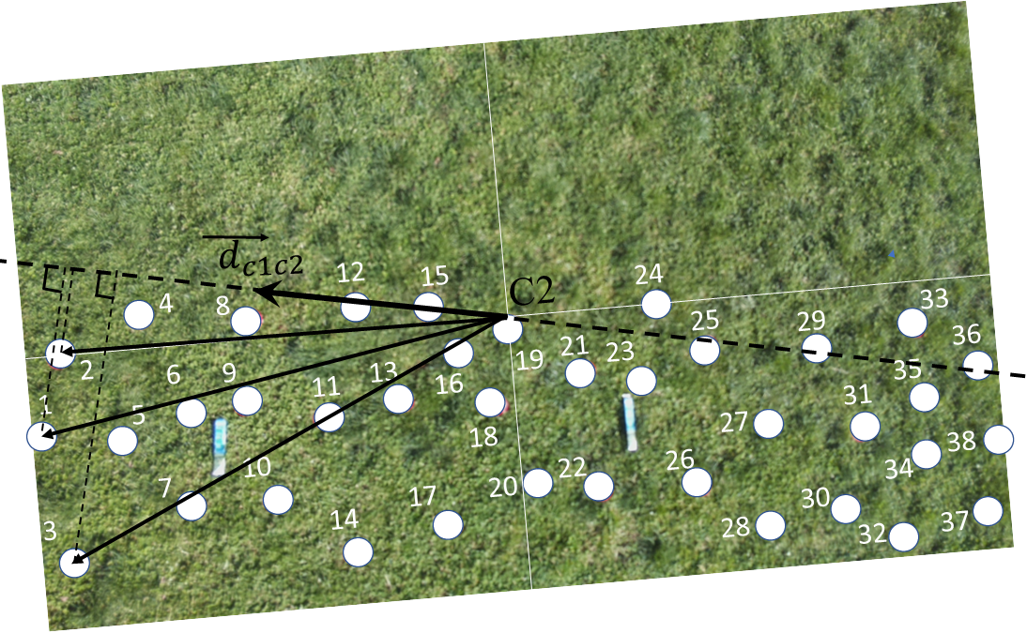
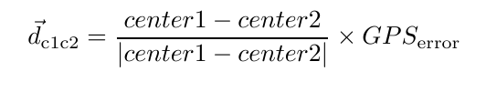

Algorithm

Slide 24
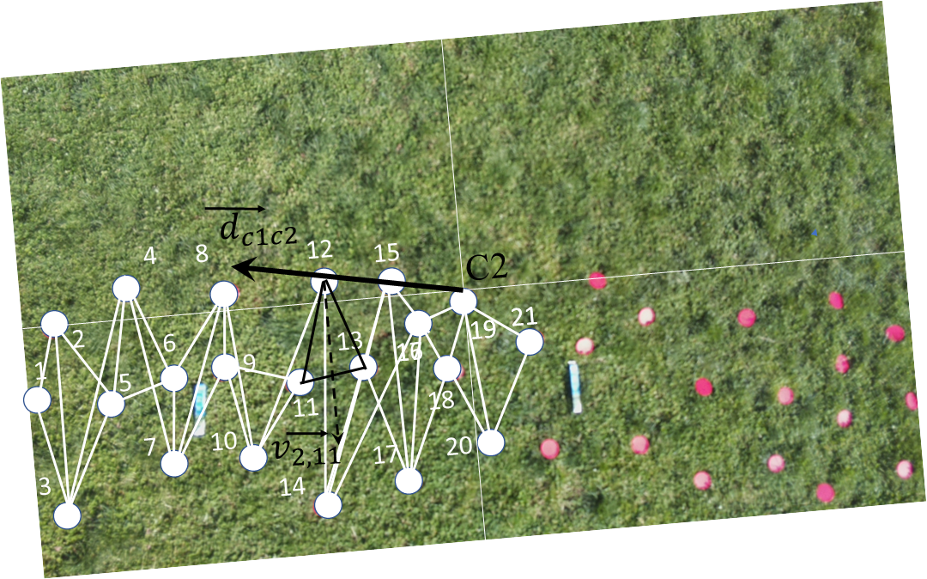
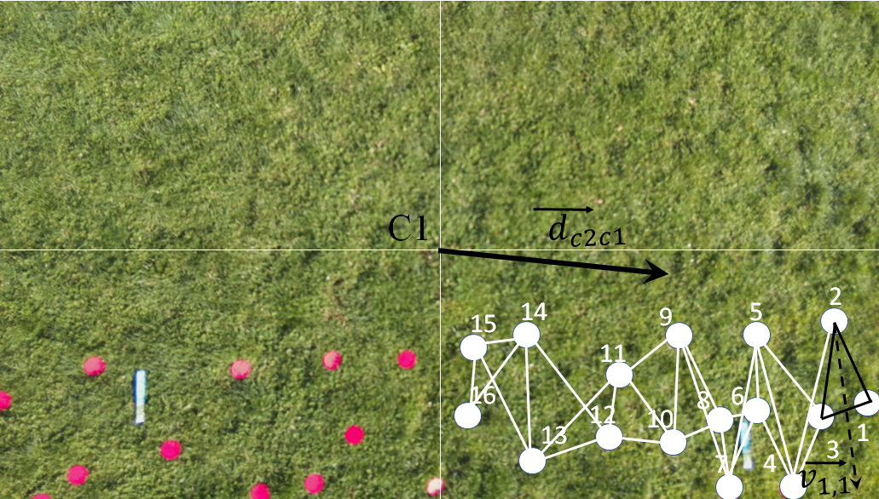
Algorithm
Three Different Patterns are proposed : Triangle, Line, Point
If triangles of first image and second image doesn’t match
It tries to match the Lines
If Lines don’t match with first image and second image
It tries to match the points,
If points doesn’t match with first image and second image,
There are no Matching targets

Slide 25
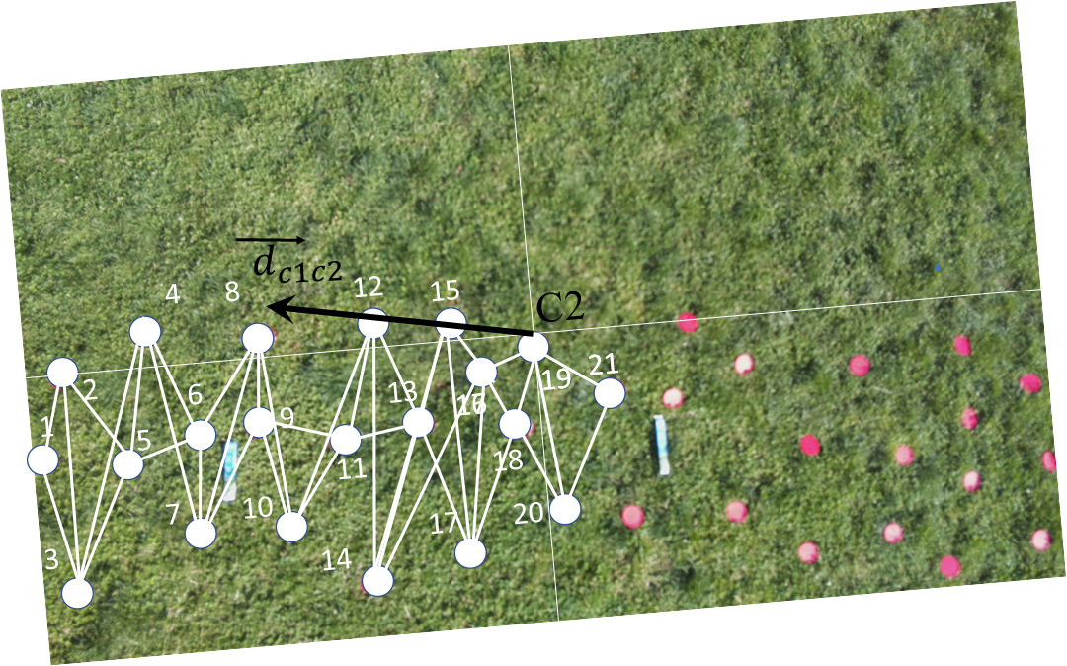
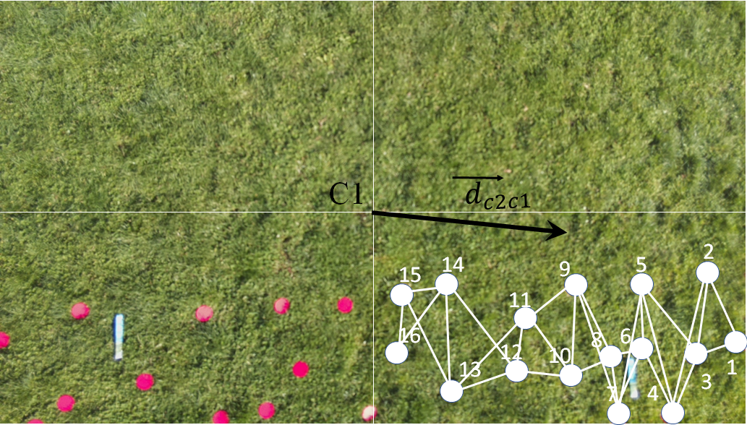
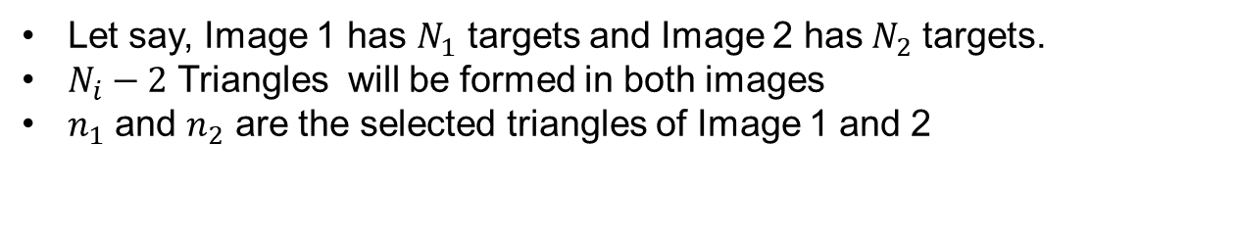
Algorithm
Image 1 with center C1
Image 2 with center C2
Let say, Image 1 has $N_{1}$ targets and Image 2 has${ N}_{2}$ targets.
$N_{i}−2$ Triangles will be formed in both images
$n_{1}$ and $n_{2}$ are the selected triangles of Image 1 and 2

Slide 26
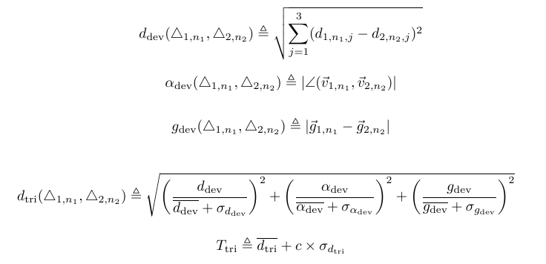
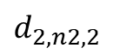
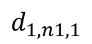
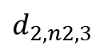
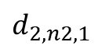
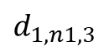
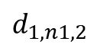
Algorithm
Distance Deviation
$d_{1,n1,1}$ < $d_{1,n1,2}$ < $d_{1,n1,3}$
$$d_{1,n1,2}$$
$$d_{1,n1,1}$$
$d_{2,n2,1}$ < $d_{2,n2,2}$ < $d_{2,n2,3}$
$$d_{1,n1,3}$$
D is a distance between two coordinates of the triangle
$$d_{2,n2,1}$$
$$d_{2,n2,2}$$
$$d_{2,n2,3}$$
18

Slide 27
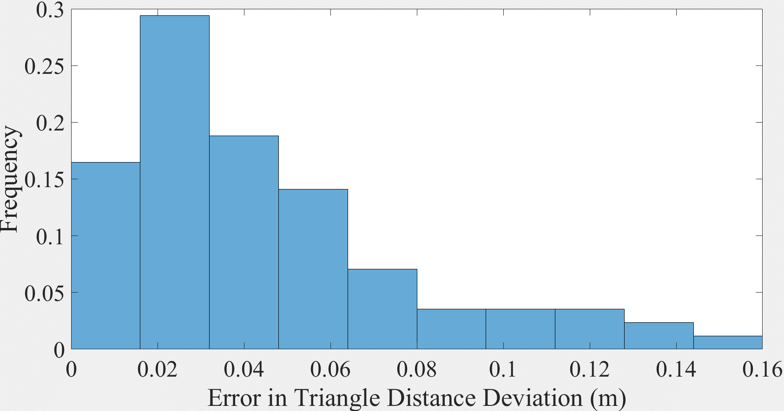
Algorithm
$\overline{d_{dev}}$ and $σ_{d_{dev}}$ are found from the Distribution of $d_{dev}$ as shown below.

Slide 28
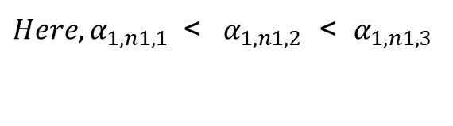

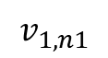








Algorithm
Angle Deviation
Triangle 1
$$α_{1,n1,1}$$
${Here, α}_{1,n1,1}$ < ${ α}_{1,n1,2}$ < $α_{1,n1,3}$
${Here, α}_{2,n2,1}$ < ${ α}_{2,n2,2}$ < $α_{2,n2,3}$
$$α_{1,n1,2}$$
$$α_{1,n1,3}$$
$$v_{1,n1}$$
$$α_{2,n2,1}$$
Triangle 2
$α$ is a angle of a triangle
$$α_{2,n2,2}$$
$$α_{2,n2,3}$$
$$v_{2,n2}$$

Slide 29

Algorithm
$\overline{α_{dev}}$ and $σ_{α_{dev}}$ are found from the Distribution of $α_{dev}$ as shown below.

Slide 30



Algorithm
Centroid Deviation
$$g_{i,ni}$$
Centroid of the Triangle is defined as
$$g_{1,n1}$$
$$g_{2,n2}$$

Slide 31
Algorithm
$\overline{g_{dev}}$ and $σ_{g_{dev}}$ are found from the Distribution of $g_{dev}$ as shown below.

Slide 32

Algorithm
$\overline{d_{tri}}$ and $σ_{d_{tri}}$ are found from the Distribution of $d_{tri}$ as shown below.

Slide 33
Algorithm
Here, Triangle 1 of Image 1 will be matched with the 11th Triangle of Image 2 because the deviation between those triangles is less then the Threshold of the Triangle deviation values.
If triangles can not identified with each other, then PSR search for Lines…

Slide 34



Distributions Of Lines
Distributions of,
Distance Deviation,
Angle Deviation,
Centroid Deviation,

Slide 35
Algorithm
Last Step is Target Counting

Slide 36
Outline
Thesis part 1 – Single UAV
System Set Up
Algorithm
Experimental Evaluation
Thesis part 2 – Multiple UAV
System Set Up
Algorithm
Experimental Evaluation
3

Slide 37


Experimental Evaluation
Pattern 1 – 80 Targets
Pattern 2 – 80 Targets

Slide 38


Experimental Evaluation

Slide 39


Experimental Evaluation

Slide 40

Sources of Error
Order of the Targets is different

Slide 41

Sources of Error
Similar Pattern Detected

Slide 42
Sources of Error
No matching Pattern Detected

Slide 43
Questions?

